Slide 1

E2 Interface – The E2 Application Protocol (E2AP)
Pratheek Upadhyaya
PhD Student, Virginia Tech

Slide 2
What is the E2 Interface?
An open interface designed for communication between the near-RT RIC and the E2 Nodes (CU/CU-CP/CU-UP/DU).
E2 Application Protocol (E2AP) is the basic procedural protocol that co-ordinates communication between near-RT RIC and E2 nodes.
Every RIC and CU/DU should follow E2AP (same message structure and procedures).
RAN Function Specific messages are conveyed through E2 Service Models (E2SM)
E2AP/E2SM Messages
E2AP
SCTP
IP
E2 Interface Protocol Stack

Slide 3
E2AP Terminology
RAN Function: A specific Function in an E2 Node (Ex: UE context handling, paging, Handover, Cell (re)configuration etc.)
  RAN Function ID: Identifier of a specific RAN function.
RIC Service: A service provided on an E2 Node.
  E2 Node provides access to messages, measurements, and/or enables control from the near-RT RIC.
  RIC Action ID: Identifier of the specific RIC service action.
Information Elements (IE): A data item containing a label field, a length indicator and a value.
Message: Group of Information Elements organized in a specific manner (often nested several levels deep). (Ex: E2 Setup Request, Setup Response, Subscription Request).
Procedure: Sequential exchange of a set of messages (Ex: Setup Procedure, Subscription Procedure, Removal, Handover procedure etc.).

Slide 4

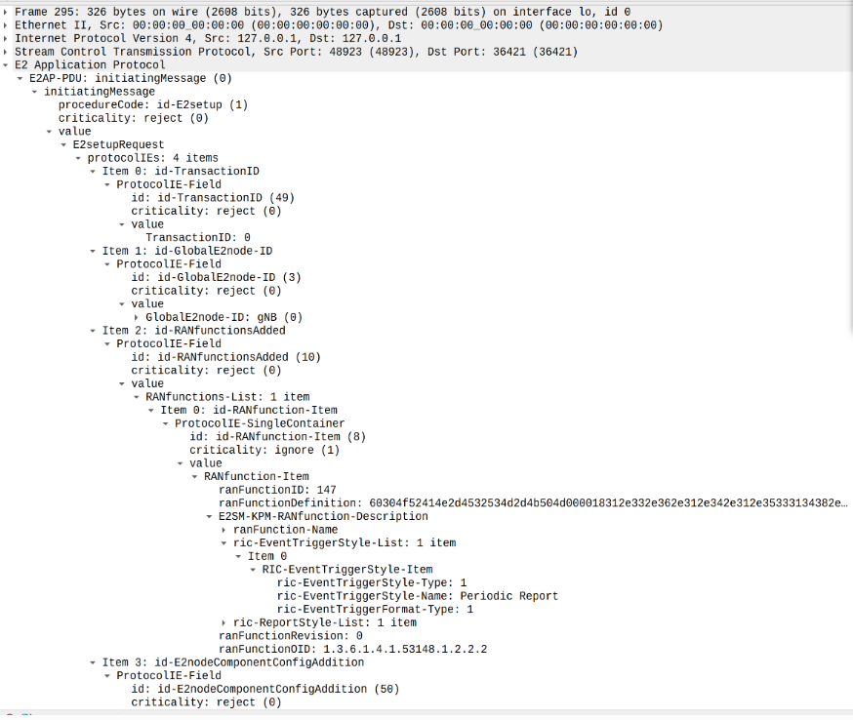
E2AP Message

Slide 5
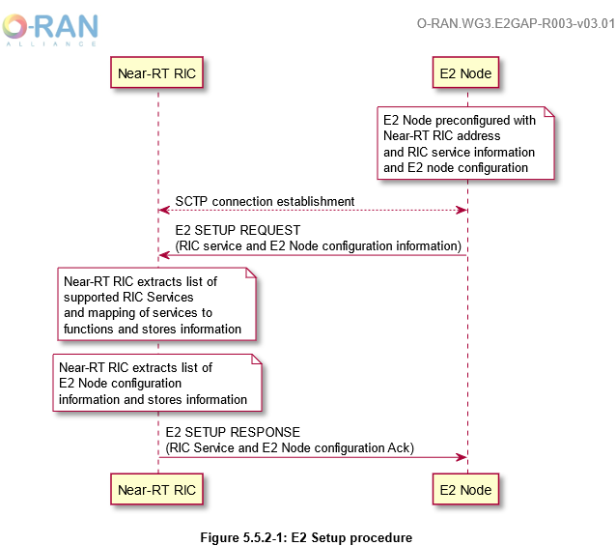
E2 Setup Procedure

Slide 6
Types of E2AP Procedures
RIC Functional Procedures: Procedures used to pass application specific messages between near-RT RIC applications and a target RAN function.
Support RIC Services – Help in getting information and events from E2 node to provide policy/control information back to E2 node
Global Procedures:
Procedures not directly related to a specific application (Ex: E2 Setup, Reset, Removal, RIC service update, RIC Query etc.)
Support Interface Management – Setup and maintenance of the E2 link between the E2 node and near-RT RIC.

Slide 7
RIC Services - Types
Report Service: The Report Service is triggered to send RIC Indication messages (of type report) that can contain data and telemetry from an E2 Node, upon subscription from an xApp.
  The report messages can be configured to be sent periodically during subscription.
Insert Service: Through the Insert service an xApp can suspend a specific procedure upon event trigger (through subscription) and get details about suspended procedures through RIC Indication messages (of type insert).
  The procedure can be halted till a timer expires/till a RIC control message is received.
Control Service: The E2 node can receive RIC Control messages triggered autonomously by the RIC (xApp) or due to the consequence of reception of an Insert message.
Policy Service: The policy service allows an xApp to request the E2 node to execute a specific policy (through a Subscription Message) after the occurrence of a specific event.
  No halting of any procedure. The E2 node adopts the policy specified.
Query Service: The E2 Node allows the RIC (xApp) to query RAN/UE-specific information.
RIC services can be combined within a common subscription with each RIC service implemented as a part of a sequence of actions.
Q: Difference between Insert and Policy services?

Slide 8
E2 Service Models (E2SM)
Each RAN Function is associated with one or more E2 Service Models.
The RIC services provided by the RAN function, the message types used, and their styles are specified in the E2 Service Model.
The Service Model also contains description of RAN function dependent Information Elements used in the E2 messages.
xApps need to have the same service Model definitions to effectively communicate with the RAN functions.

Slide 9
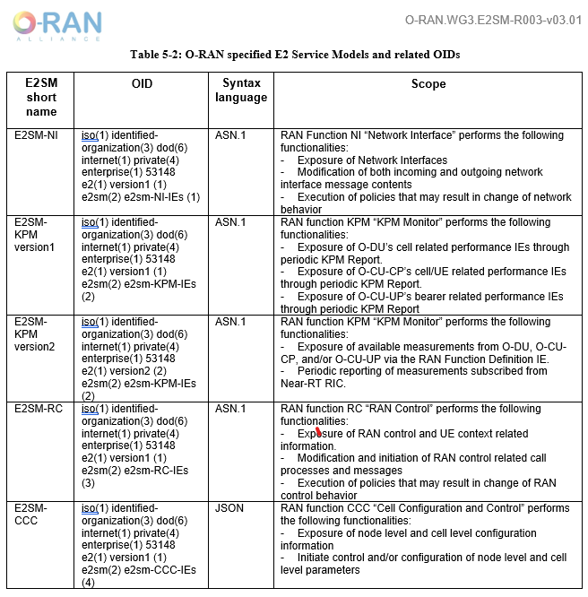
O-RAN Standardized Service Models

Slide 10
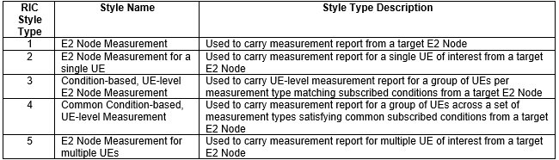
E2SM-KPM
The Key Performance Metrics (KPM) Monitor RAN function exposes available measurements from O-DU, O-CU-CP, O-CU-UP and periodically reports measurements subscribed from near-RT RIC (xApp).
The KPM Monitor RAN function provides the Report service in the following styles
  E2 Node Measurement.
  E2 Node Measurement for a single UE.
  Condition-based, UE-level E2 Node Measurement.
  Common Condition-based, UE-level E2 Node Measurement.
  E2 Node Measurements for multiple UEs.
Style Type: A specific approach used to expose a given RIC service.
Format Type: A specific approach used to encode one of the E2AP IEs defined in the E2SM.

Slide 11
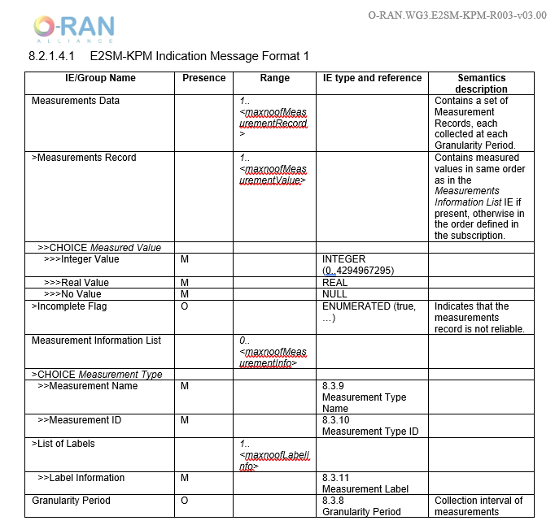
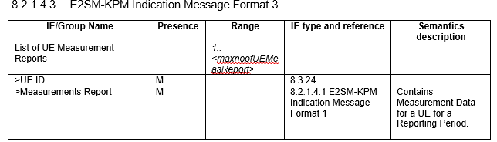
E2-SM Message formats

Slide 12
Explore ASN1 file for E2SM-KPM
Q: What is the Purpose of E2SM?
Ans: Recommended approach that a given RAN function specific E2SM would use to define the contents of E2 messages
Q: What would happen if custom service Models are implemented instead of standardized ones?

Slide 13
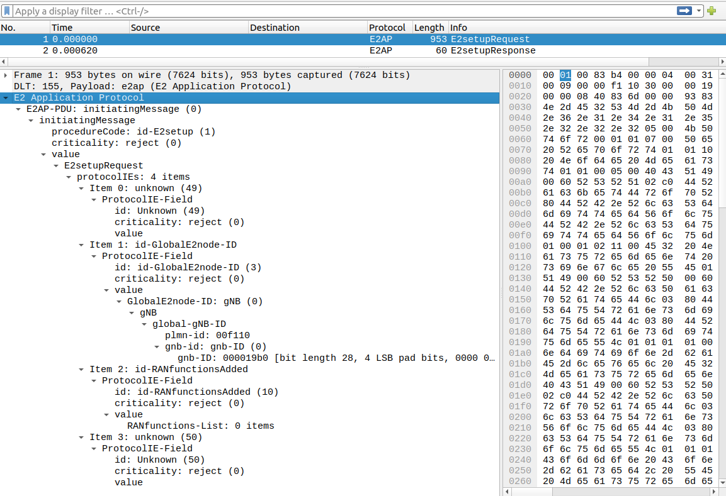
E2 Packet Captures (E2 Setup Request)

Slide 14
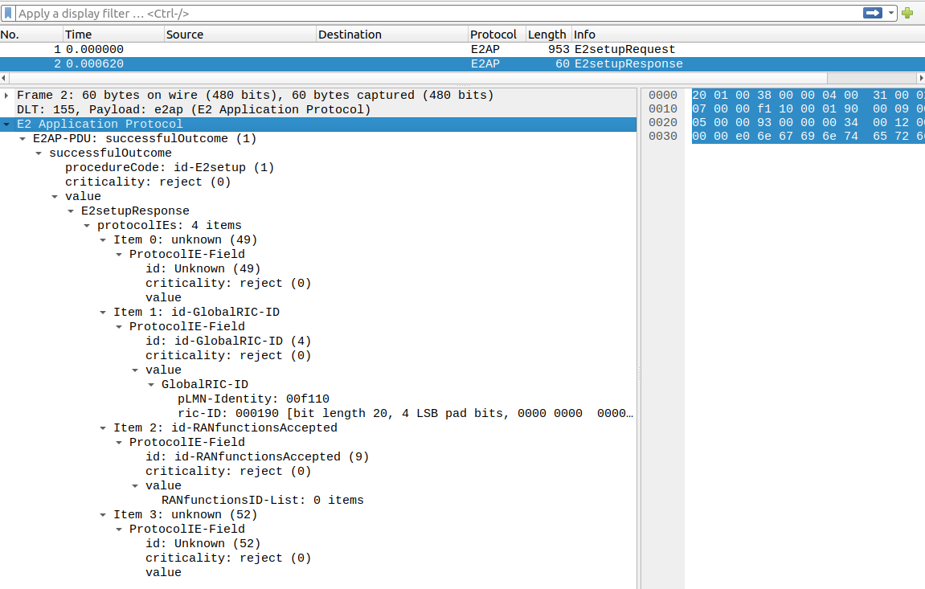
E2 Packet Captures (E2 Setup Response)

Slide 15
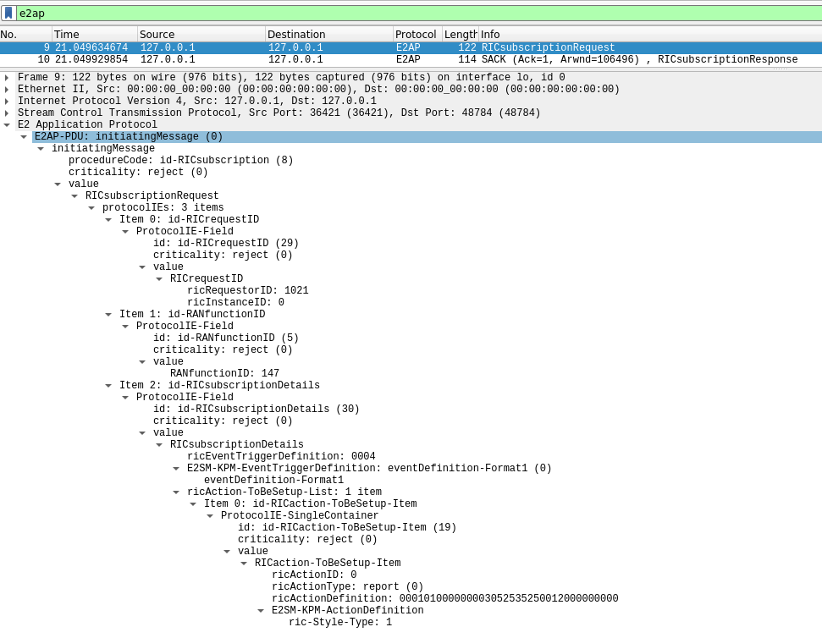
E2 Subscription Request

Slide 16
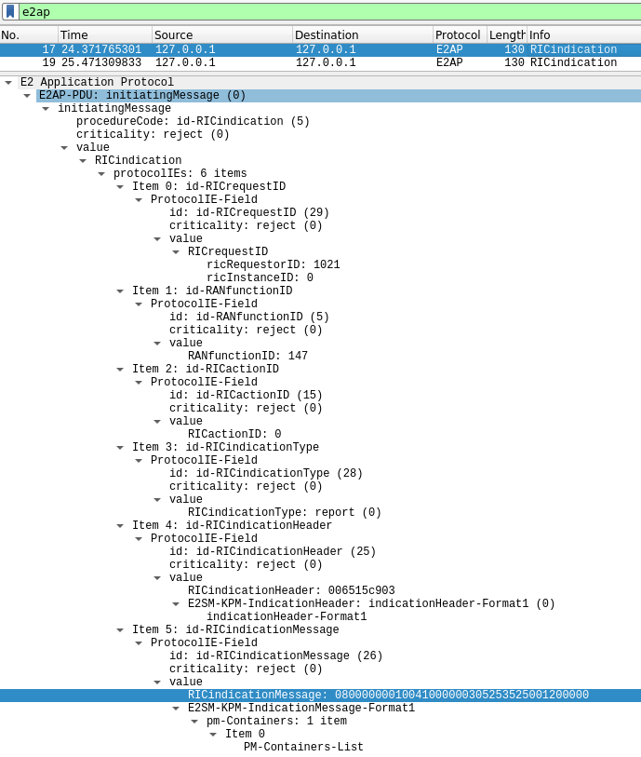
E2 Indication Message Capture

